Slide 1
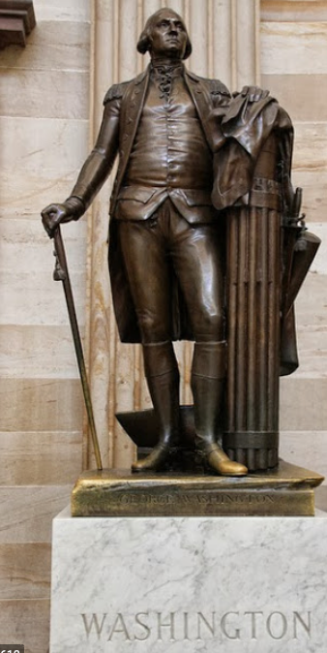

Fascism
Fascism & the Young Mussolini:
Fasces carried by lictors in the Roman Republic to signify the magistrate’s imperium
“We are a bundle of sticks, and we are strong”
Mussolini the young socialist
The socialist Second International’s July 29, 1914 Brussels meeting
The collapse of the Second International
Austrian socialist leader Viktor Adler: “better to be wrong with than right against the working class”
Four only out of fifty stuck to their pacifist guns: Hasse, Luxemburg, Leibknecht, and Lenin
Mussolini was shaken
To lead a mass movement, you need to put yourself at its head
Mussolini became a nationalist, and the first fascist
3:30 of audio in this slide; 11:00 in this slide group
Notes:
In ancient Rome, the fasces had been a bundle of sticks about five feet long, tied with leather thongs, marking the power to command: imperium. You can see the fasces on the back of the American winged-liberty dime that was minted until 1945, in the U.S. Treasury Department’s stair bannisters, on the arms of the chair in which Abraham Lincoln sits in the Lincoln Memorial, and in the statue of George Washington. The symbology is clear. Each stick is weak and easily broken. Bundled together and tied with leather thongs, they are strong. Individual Romans are weak. The Roman people united under the commands of their elected magistrates their very strong indeed.
In the aftermath of World War I, young Italian journalist-politician on the make Benito Mussolini took up this Roman Republican symbol and became the first fascist, the first united-and-tied-together-we-are-powerful-like-a-bundle-of-sticks guy.
Mussolini had started out as a socialist journalist. By the eve of World War I he had become one of Italy’s most prominent.
As World War I began, representatives from all of Europe’s socialist parties came together in Brussels on July 29, 1914 for a meeting of the world’s Second Socialist International. Earlier, the united world socialist movement had agreed that a threatening war should be met by a general strike to bring the war machine to an immediate halt. Then diplomats could do their work.
But in Brussels the Austrian socialist leader Viktor Adler announced that the workers of Vienna were in the streets chanting for war. “It is better to be wrong with the working classes than right against them”, Adler said: the Austrian socialists would support their Kaiser. In France, the President of the Council of Ministers was socialist Rene Viviani, who called on French workers to defend their country. Only four out of fifty or so major socialist leaders stood against this war: Hugo Hasse, Rosa Luxemburg, and Karl Leibknecht from Germany; and Vladimir Lenin from Russia.
Mussolini, however, was shaken by the collapse of the Second International in the face of the forces of nationalism. “Cardi, Corridoni, la Rygier, apologists for war! It is a contagion that spares no one! But I want to hold the rampart to the end.” But, he thought: “The Second International is dead”.
Mussolini decided that if the Italian workers he wanted to lead were going to be nationalists first and socialists second, he would join them. Mussolini was not the kind of person to stand alone. He was not George Orwell, had a duty to go against the crowd especially when “to see what is in front of one’s nose needs a constant struggle.” He was not Henrik Ibsen’s character Dr. Stockman: “the strongest man is he who stands most alone”. Mussolini’s identity was as a leader—he hoped the leader—of a mass movement. And, as his enemies say French politician Andre Ledru-Rollin said in 1848: “there go my people, and I must follow them for I am their leader”. You might be able to redirect the parade, but only if you first put yourself at the head of it.
The enemies of Mussolini and of his movement would be not aristocrats and members of the business class, but external and internal enemies of the Italian people.

Slide 2
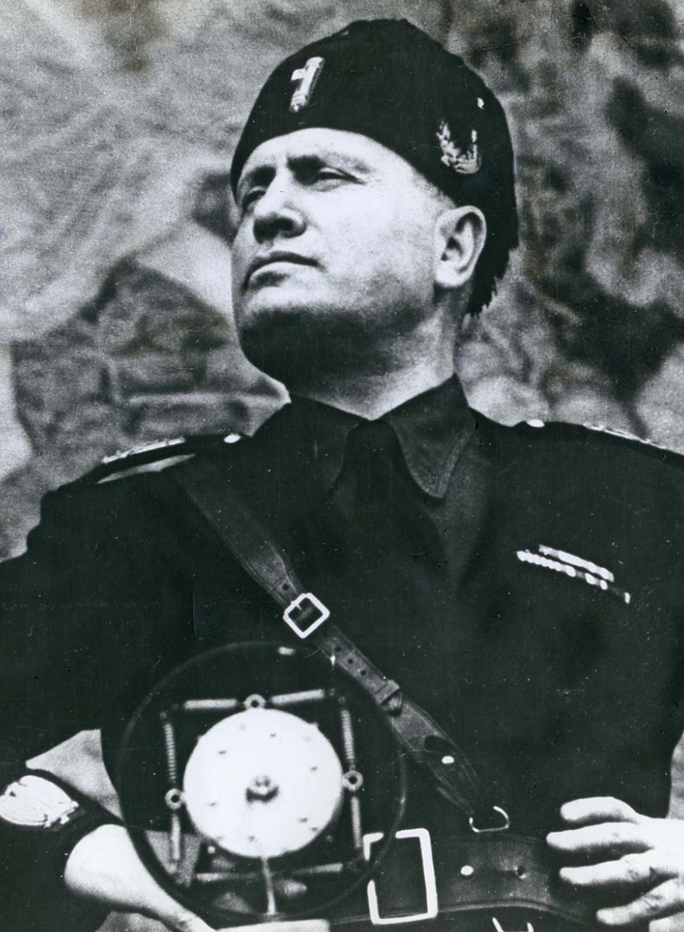
But What Was This “Fascism” Going to Be?
At the start, a placeholder:
Fascism as critique: the classical liberal order had failed
Macroeocnomic failure
Distributional failure: treating equals unequally and unequals equally
Moral failure: market exchange corrosive of social solidarity
Related: government mediation needed to keep those with market power from extracting pounds of flesh
The cretinism of parliaments and the need for a leader
Fascism’s positive policy platform
Ethno-nationalist assertion against external enemies
Ethno-nationalist assertion against internal enemies—those who would mislead and divide the people
Make the market work for the full members of the rightful nation, not for others
A leader to enforce order: “make the trains run on time”
Was this real, or just a con game run by mountebanks and grifters who wanted to live off of politics?
5:00 of audio in this slide
Notes:
But what was this “fascist” movement going to be?
Originally Mussolini just had an observation: the working classes were hard to mobilize for a largely-economic internal struggle of protests, demonstrations, strikes, and votes to obtain respect and an end to poverty; they were easy to mobilize for a bloody and destructive war to reclaim, or rather claim, Alto Adige, Trentino, Frulia, Udine, and the city of Trieste.
Mussolini therefore felt his way forward.
The easiest first step was that liberal capitalism had had its chance and had failed along several dimensions.
A first was macroeconomic failure: it had not guaranteed high employment and rapid economic growth.
A second was distributional failure: the rich got richer, and did not deserve it. The market failed to preserve an adequate income differential between the more-educated, more-respectable lower middle class and various of the unskilled and unworthy, who also did not deserve as much in the way of good things as they got. Fascism could and did play both ends against the middle: under liberal democratic capitalism, equals were treated unequally, while unequals—those who were not really part of the ethno-nationalist community—were treated equally.
A third was moral failure: people are not comfortable dealing with each other as nothing but black-box machines for transforming your money into useful commodities, or your labor time into your money. Contests and gift-exchanges have more psychological resonance.
Fourth, the liberal capitalist order ignored the solidarity of an ethnic nation. Thus economic policy needs to be made in a “syndicalist” or “corporatist” mode: with the state mediating between members of the national community, rather than just standing by and letting those with market power extract their pounds of flesh.
Fifth, the liberal government was flawed: parliaments were incompetent, composed (a) of time-servers with no initiative, (b) corrupt distributors of favors to special interests, and (c) ideological champions who focused not on the wellbeing of the people but what made their own narrow slice of supporters feel good: a swamp that needed to be drained by a strong leader, who would say what he thought and do what was needed without paying attention to norms or niceties was needed to do the job.
Thus nationalist expansion became Mussolini’s first plank: demanding that the Italian border be moved north into the Alps and east into what would become Yugoslavia, as far as possible. Anti-socialism became his second plank: recruiting groups of young thugs and sending them out into the streets to beat up socialists and disrupt working-class organizations.
He was appealing to the same sources of discontent and energy that the socialists were, and so needed to sharpen the contradictions to keep his own recruits from drifting left. Back in the early second century St. John the Evangelist had needed his congregation to stop dividing their contributions between church and synagogue, hence his gospel demonized the Jews. Mussolini’s—and Hitler’s—gospels needed to do something analogous to recruit cadres.
“Corporatism”: replacement of the anarchy of the market by some form of government-administered planning, at least of wage levels and incomes, became his third plank. Fascism would embrace the dignity of work and of occupations, and not value every form of work and every worker by what the market wanted to pay in some equilibrium. Thus policy needed to be made in a “syndicalist” or “corporatist” mode, with the state mediating between those who thought they had opposed interests, for example employers and unions, and remind them that they had much more in common as ethnic Italians than divided them as members of different classes.
And to make people sit up and behave—subordinate their class interests to the ethno-national interest—there needed to be a strong leader: Mussolini. People did not have interests that politicians existed to satisfy. Instead, people needed to be led and given a sense of national purpose by having their leader tell them what their interests were. Rulers should not listen and obey, but speak and command.
Was this real, or was this just a con game run by mountebanks and grifters who wanted to live off of politics? And who thought they could delude easily-grifted morons who could be taught to fear others, both foreign and domestic, whether or not those others posed any real threat?

Slide 3
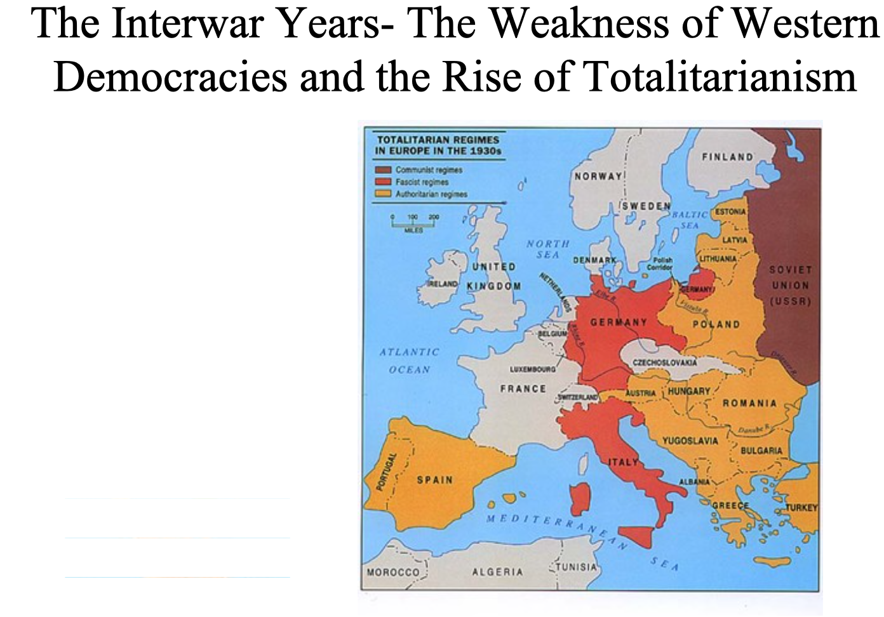
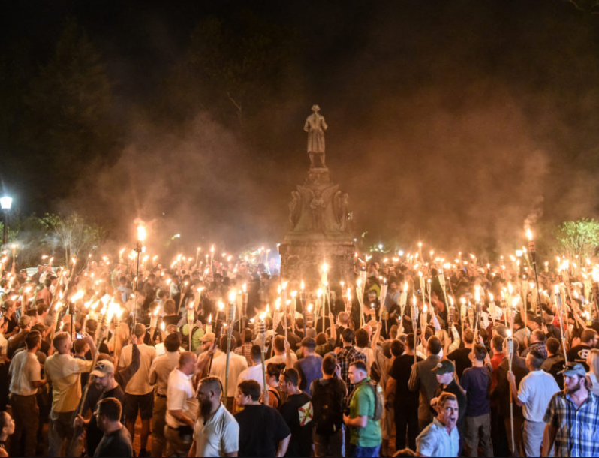
Fascism the Interwar Wave of the Present—& of the Future
Too many resonances to be dismissed as only a con game:
Six facets of really-existing fascist movements:
leadership commanding rather than representing
blood and soil
coordination and propaganda—telling people what they should think, aggressively
approval of (some) traditional hierarchies
hatred of socialists and liberals as ineffective and effeminate
hatred of “rootless cosmopolites” of some form or other in some form or other
On the eve of World War II, only 12 1/2 stable democracies worldwide
2:30 of audio in this slide
Notes:
But while it is certainly true that “fascism” was disorganized, self-contradictory, confused, and vague, most political movements are disorganized, self-contradictory, confused, and vague. In forming a coalition or a party the goal is to maintain friendships and alliances by the blurring of differences and the vagueiﬁcation of concepts inside the group, and not to obtain conceptual clarity, or logical, or correct thought.
Fascism in the twentieth century has had too many adherents to be a nonexistent illusionary confidence trick, even if most fascists most of the time were clearer on what they were against than what they were for. I count six elements usually found—in Italy and elsewhere—in regimes that called themselves “fascist”: a leadership commanding rather than representing, a unified community based on ties of blood and soil (and rejecting and degrading those who are not of the community), coordination and propaganda, support for at least some traditional hierarchies, hatred of socialists and liberals, and—almost always—hatred of “rootless cosmopolites” in some form or other.
What gave it strength was that after World War I, fascism was the only game in town if you did not approve of liberal democracy, or if you feared socialism and thought that liberal democracy would lead to really-existing socialism once the working class realized its voting strength. Monarchy was out. An aristocracy of birth and rank was out. Theocracy was out. Plutocracy had… difficulties keeping a mass base. Fascism was it. And a lot of people were and are willing to endorse and support it.
Indeed, if you took a look at European and Latin American governments between the World Wars, you could easily convince yourself that fascism was the wave of the future. Nearly everywhere democracy was in retreat, unable to provide answers to the economic problems of the Great Depression or to resolve social conflicts.
On the eve of World War II democracies in the world were few and far between: Great Britain and its Dominions (Australia, New Zealand, Canada, and perhaps South Africa), the United States (if you were white), Ireland, France, Belgium, Holland, and Scandinavia (Sweden, Norway, and Denmark). That was it. Everywhere else you had authoritarian, non or anti-democratic governments of the left or the right.

